Slide 1
Course Capstone
Data Collection

Slide 2
AdWord Ads Clicks
Mean, Median, and Mode help you compare data. Below, list the mean, median, and mode of the clicks in the provided data.
Mean: 60.383
Median: 60
Mode: 78

Slide 3
AdWord Ads Conversions
Mean, Median, and Mode help you compare data. Below, list the mean, median, and mode of the conversions in the provided data.
Mean: 5.9808
Median: 6
Mode: 5

Slide 4
AdWord Ads Standard Deviation
Determining variance in data helps you. Below, enter the standard deviation of the provided data.
Standard Deviation of Clicks: 14.368
Standard Deviation of Conversions: 1.628

Slide 5
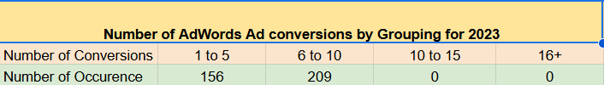
Frequency and Contingency Tables
Understanding how often something happens is important to understanding trends and patterns in your data. Create and insert a contingency table generated from your data.

Slide 6
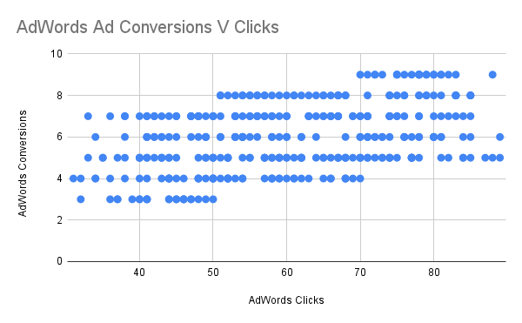
Scatter Plot
Understanding the relationships between data is important to understanding trends and patterns. Create and insert a scatter plot generated from your data. Then, include the input the correlation coefficient as well.
Scatter Plot of your data:
Correlation coefficient: 0.44799

Slide 7
End of Module 1

Slide 8
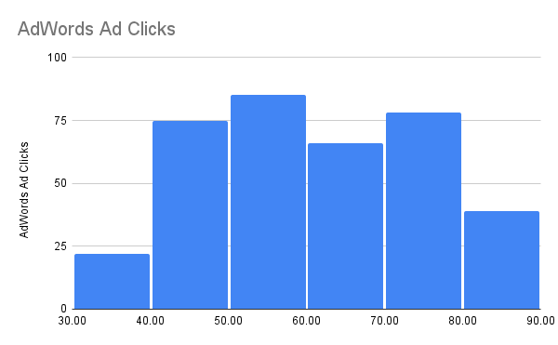
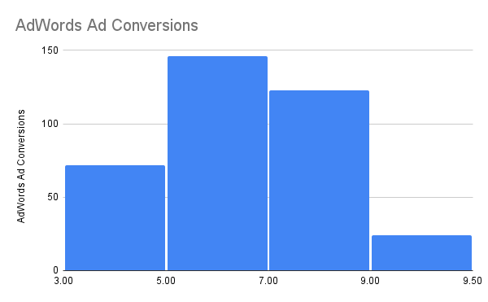
Sample Type
It’s important to understand the sample you’re using in your analysis. Fill in the information below about the sample you have received:
Histogram of your clicks data:
Histogram of conversions data:

Slide 9
Module 2: Sample Type
It’s important to understand the sample you’re using in your analysis. Fill in the information below about the sample you have received:
Does the clicks data have a normal distribution?
No it does not have normal distribution
Does the conversions data have a normal distribution?
Yes it does.

Slide 10
Variable Types
Determining the types of variables your working with is an important skill. Below, list the variables from your data that are:
Quantitative:
Continuous: AdWords Click-Through Rate, AdWords Conversion Rate, AdWords Cost per Click.
Discrete: AdWords Ad Views, AdWords Ad Clicks ,Cost per AdWords Ad.
Qualitative:
Nominal: N/A
Ordinal: N/A

Slide 11
End of Module 2

Slide 12
Question and Hypothesis
The question you hope to answer and your hypothesized answer are necessary to complete an analysis. Answer the following questions
What is your hypothesis based off the evaluation question?
Our number of conversions will be greater if we advertise more on Facebook in comparison to AdWords Ad.

Slide 13
Question and Hypothesis
The question you hope to answer and your hypothesized answer are necessary to complete an analysis. Answer the following questions
What is your independent variable?
Clicks
What is your dependent variable?
Conversions

Slide 14
Running a Test
With your question and hypothesis ready, run the test on the two sets of data. Fill in the information below.
Mean number of Facebook conversions: 11.74246575
Mean number of Adware conversions: 5.980821918
p-Value: 0

Slide 15
Hypothesis
After running the test, was your hypothesis proven correct?
Do your findings support a null or an alternative hypothesis?
My findings support an alternative hypothesis.
T-test formula gives a p-value that is less than 𝛂(0.05), that means the difference between “Facebook Ad Conversions” and “AdWords Ad Conversions” is a statistically significant difference. It proves that alternative hypothesis(H1) should be accepted. This answers resonates with our hypothesis that “Our number of conversions will be greater if we advertise on Facebook Ads rather than AdWords Ads.”

Slide 16
End of Module 3

Slide 17
Determining a Model
Based off what you know so far, you’ll need to determine if your data meets the assumptions for a chosen model. Including:
Which model makes the most sense to use and why?
Since the independent variable i.e ‘Facebook Ad clicks’ is Quantitative and the dependant variable i.e ‘Facebook Ad conversions’ is also Quantitative. Therefore the use of Simple Regression Model is the most suitable to make predictions.

Slide 18
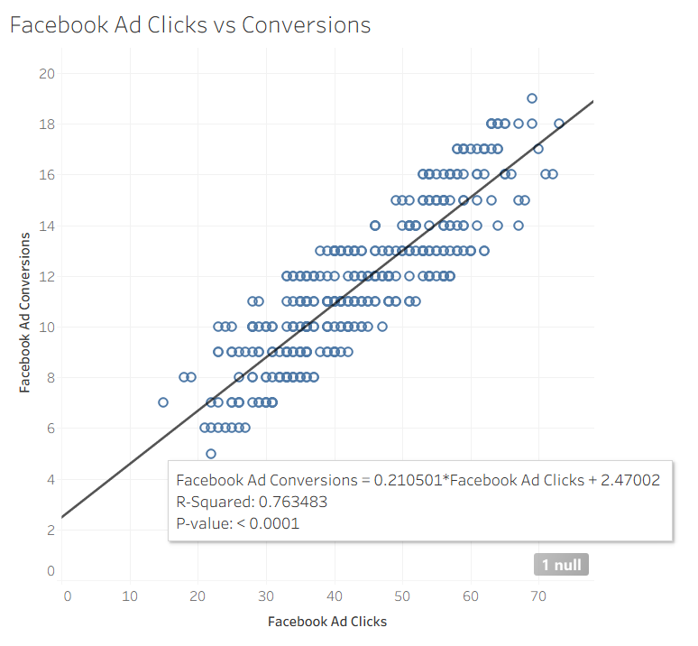
Modeling
Finally, include a visualization of your complete model.

Slide 19
End of Module 4

Slide 20
Final Insights
Now, knowing what you do about the results of your test, what are the final insights that you would share with your client? What did you learn and what would you recommend? Is there anything you would do differently next time?
Key Insights
The regression equation—Facebook Ad Conversions = 0.210501 × Facebook Ad Clicks + 2.47002—indicates that for every additional click on a Facebook ad, average conversions increase by about 0.21.
An R-squared value of 0.76 signifies that 76% of the variation in conversions can be explained by clicks, highlighting a robust relationship.
Based on these findings, it is recommended to continue or increase investment in Facebook advertising and use this model to guide budget and campaign planning. For even better results, future analyses could include additional variables such as creative type or audience segments to refine predictions and optimize ad performance. Overall, these insights provide clear evidence that Facebook ad clicks are delivering substantial value for driving conversions.

